Slide 1

DEVELOPING AN
AL
EFFECTIVE
TEAM
DEPARTMENT OF IOWA LEADERSHIP SCHOOL
PRESENTED BY: Polly Graham
30 May 2026
FOR GOD AND COUNTRY

Slide 2
OPENING
Think of the best team you've ever been part of.
What made it work?
Take 60 seconds. Share with the group.
Trust
Purpose
Leadership
People believed in each other
Everyone knew why it mattered
Someone set the tone
AMERICAN LEGION LEADERSHIP DEVELOPMENT
Slide 2

Slide 3
TODAY'S AGENDA
1
Know What You're Walking Into
PREPARE
2
Four Things Every Team Needs
TIME COUNTS
3
The Leader's Job
HABITS
4
Your 90-Day Action Plan
ACCOUNTABLE
AMERICAN LEGION LEADERSHIP DEVELOPMENT
Slide 3

Slide 4
1
KNOW WHAT YOU’RE
WALKING INTO
The core framework
AMERICAN LEGION LEADERSHIP DEVELOPMENT
Slide 4

Slide 5
1
KNOW WHAT YOU'RE WALKING INTO
PREPARE
01
02
03
Who is already
doing the work?
Who has been
sitting out?
What is the biggest need? (Post/District/Dept)
Find the 2–3 members keeping things running. Make sure they don't burn out — they are your foundation.
Members who attend but are never asked to help are untapped resources. Seek them out personally.
Recruiting? Community service? Finances? Morale? That need shapes the team you build first.
AMERICAN LEGION LEADERSHIP DEVELOPMENT
Slide 5

Slide 6
2
FOUR THINGS EVERY
EFFECTIVE TEAM NEEDS
The core framework
AMERICAN LEGION LEADERSHIP DEVELOPMENT
Slide 6

Slide 7
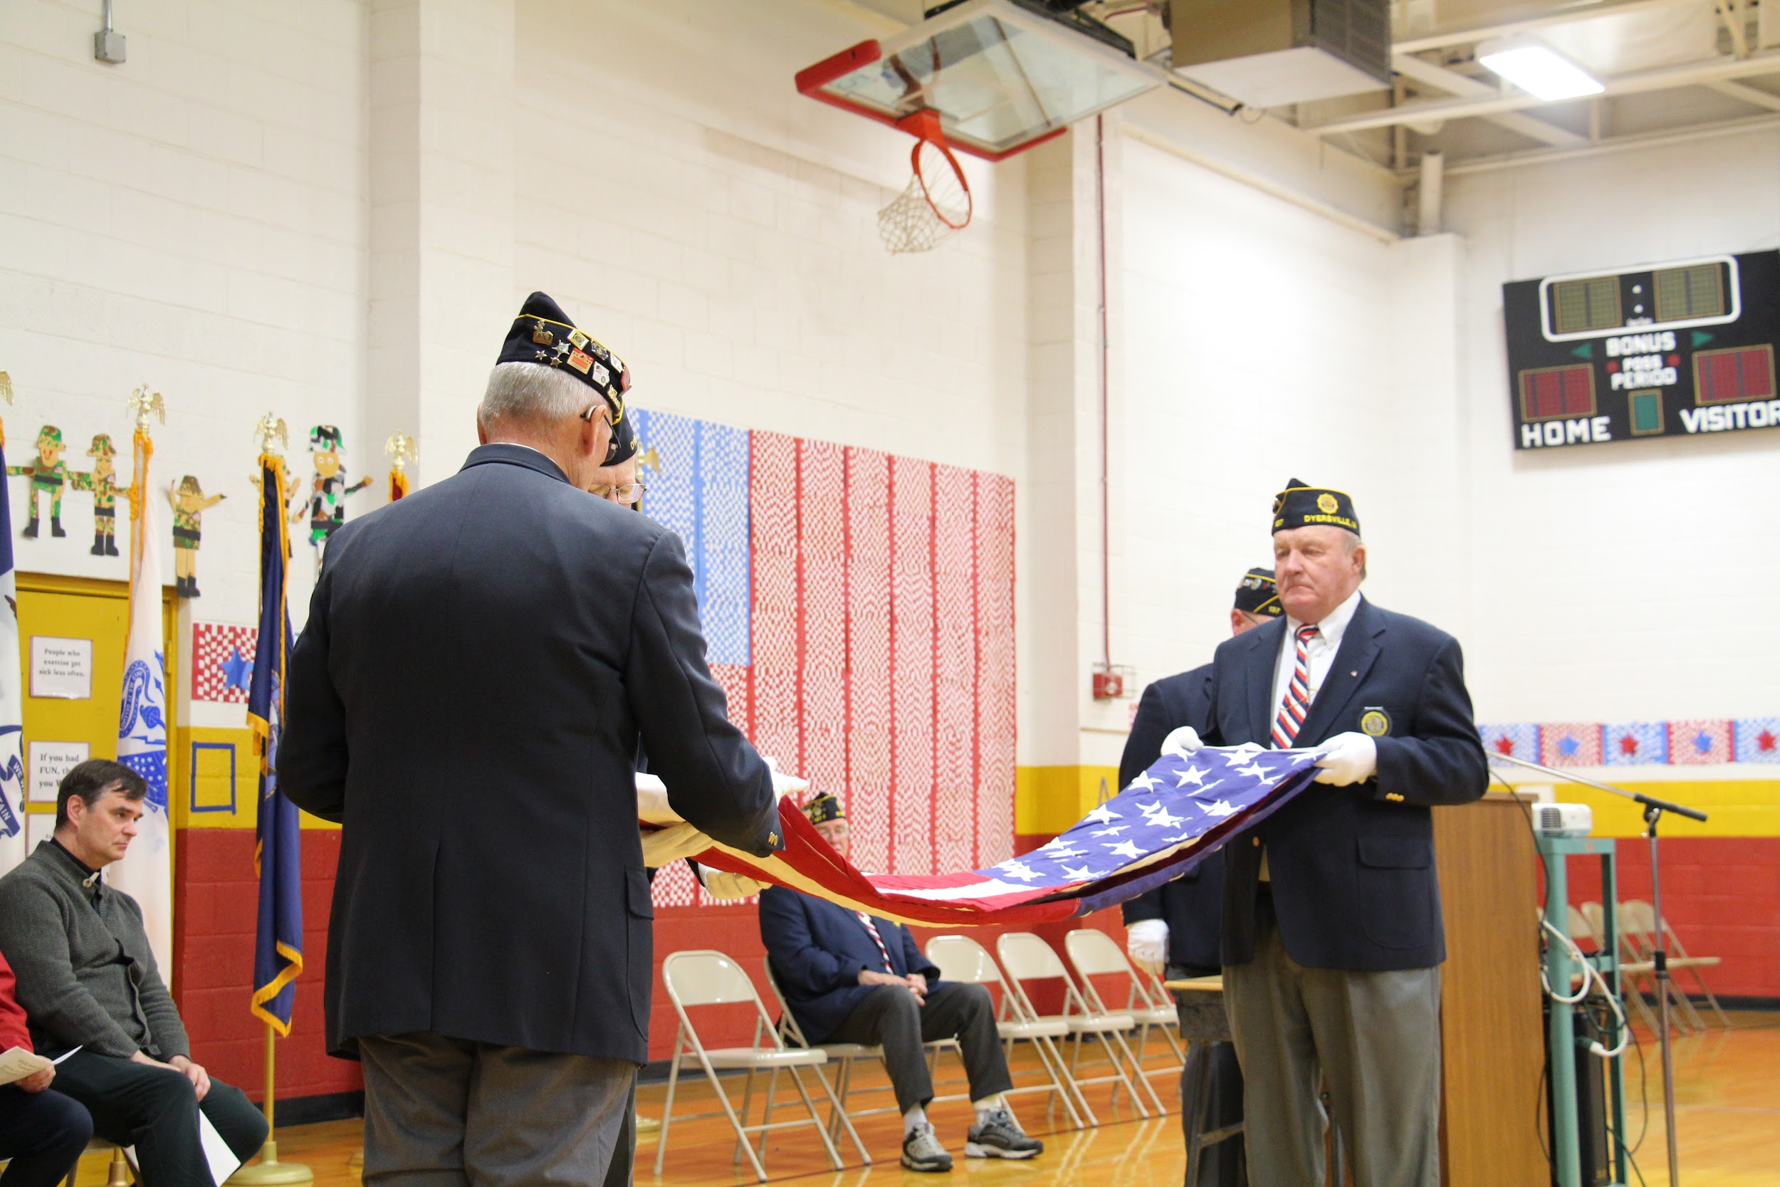
2
FOUR THINGS EVERY TEAM NEEDS
TIME COUNTS
01
CLEAR PURPOSE
PROVIDE THE “WHY
ESTABLISH THE VISION
CONNECT TO MISSION
AMERICAN LEGION LEADERSHIP DEVELOPMENT
Slide 7

Slide 8
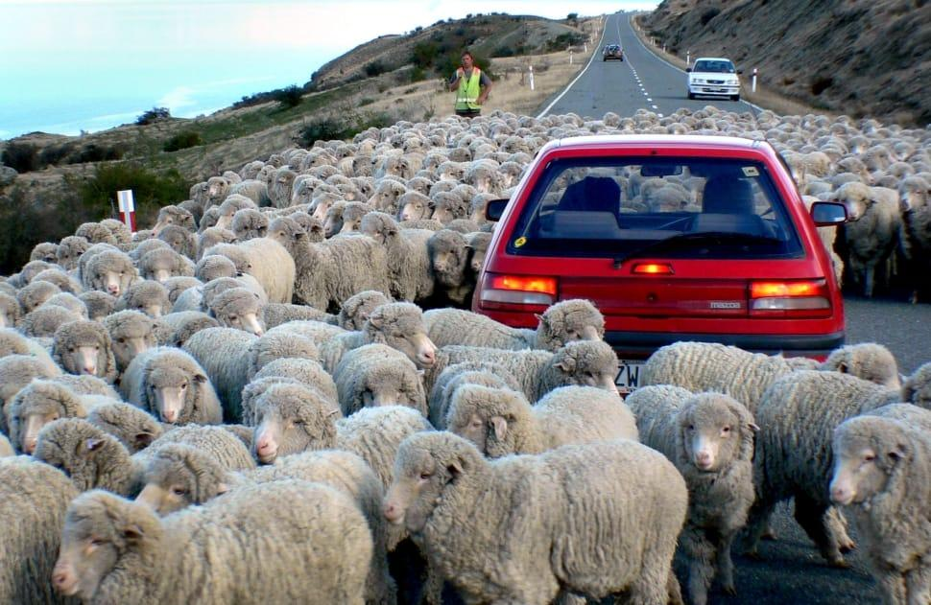
2
FOUR THINGS EVERY TEAM NEEDS
TIME COUNTS
02
DEFINED ROLES
PREVENT CONFUSION
APPOINT IN-CHARGE(S)
COMMUNICATION MEANS
AMERICAN LEGION LEADERSHIP DEVELOPMENT
Slide 8

Slide 9

2
FOUR THINGS EVERY TEAM NEEDS
TIME COUNTS
04
VISIBLE WINS
ABILITY TO TRUST
ENGAGE DEBATE
ACHIEVE COLLABORATION
AMERICAN LEGION LEADERSHIP DEVELOPMENT
Slide 9

Slide 10

2
FOUR THINGS EVERY TEAM NEEDS
TIME COUNTS
04
VISIBLE WINS
ALIGNMENT AROUND GOALS
SHARE THE IMPACT
DELIVER THE “WOW”
AMERICAN LEGION LEADERSHIP DEVELOPMENT
Slide 10

Slide 11
2 | FOUR THINGS EVERY EFFECTIVE TEAM NEEDS TIME
TIME
01
02
CLEAR PURPOSE
DEFINED ROLES
People volunteer their time — they need to know WHY the work matters, not just WHAT the task is. Connect every role to the Legion's mission.
Confusion about who owns what, kills momentum. Even informal teams need someone clearly in charge of each function. Name it.
03
04
PSYCHOLOGICAL SAFETY
VISIBLE WINS
Build positive relations. Members must feel free to raise problems and disagree without being shut down. Veteran culture can default to rank-based silence — practice no rank culture
Celebrate completions, big and small. Recognition is the fuel that keeps volunteers coming back month after month.
AMERICAN LEGION LEADERSHIP DEVELOPMENT
Slide 11

Slide 12
3
THE LEADER’S JOB
IN DEVELOPING AN EFFECTIVE TEAM
DEVELOP HABITS
AMERICAN LEGION LEADERSHIP DEVELOPMENT
Slide 12

Slide 13
3
THE LEADER'S JOB
HABITS
Your team will reflect your habits.
01
Listen First, Direct Second
Spend your first 30 days asking more questions than you give answers. You will learn things no org chart can show you. Members who feel heard become committed volunteers.
02
Delegate With Trust
Give someone a job and let them do it. Hovering signals distrust and drives your best people away. Assign the task, set the expectation, then step back.
03
Steer - Pivot - Pass the Torch
Start with a vision and find the North Star. Practice continuous improvement. Everyone gets their say, not everyone gets their way. Pivot. Exceed expectations.
AMERICAN LEGION LEADERSHIP DEVELOPMENT
Slide 13

Slide 14
4
YOUR 90-DAY
ACTION PLAN
ACCOUNTABLE
AMERICAN LEGION LEADERSHIP DEVELOPMENT
Slide 14

Slide 15
4 | YOUR 90-DAY ACTION PLAN
ACCOUNTABLE
The Accountability Ladder
To Cope With Change
GOWI -Get On With It
Make it Happen
Find Solutions
Get To Top Rung
Own It
Acknowledge Reality
Wait & Hope It Gets Better
Climb Above 3rd Rung
Make Excuses or Reason “I Can’t”
Blaming Others
AMERICAN LEGION LEADERSHIP DEVELOPMENT
Slide 15

Slide 16
4 | YOUR 90-DAY ACTION PLAN
ACCOUNTABLE
Write your answers on the handout. This is your personal accountability tool.
30 DAYS
One person at my post I will personally recruit to a role:
90 DAYS
One team need I will address:
TODAY
One leadership habit from this class I commit to practicing:
AMERICAN LEGION LEADERSHIP DEVELOPMENT
Slide 16

Slide 17
TAKE THE LEAD.
1
Assess before you build
2
Every team needs purpose, roles, safety, and wins
3
Listen first — lead second
4
Commit to your 90-day plan today
FOR GOD AND COUNTRY

Slide 18
Thank You/Q&A
Your Post/District/Dept is counting on you to:
1
DREAM
2
DRIVE
3
INSPIRE
4
IMPACT
FOR GOD AND COUNTRY

