Slide 1


Mike Vaughn - Director

Slide 2


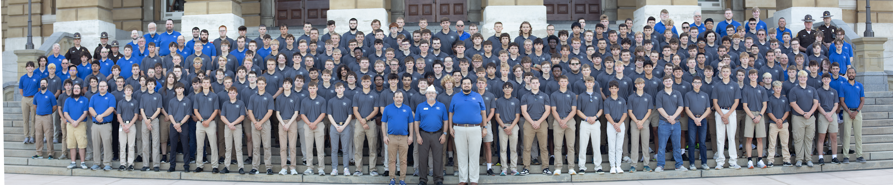
Agenda
Where we’re sitting today
Evolution of Iowa Boys State
District / Posts Roles
Invitation for Engagement

Slide 3
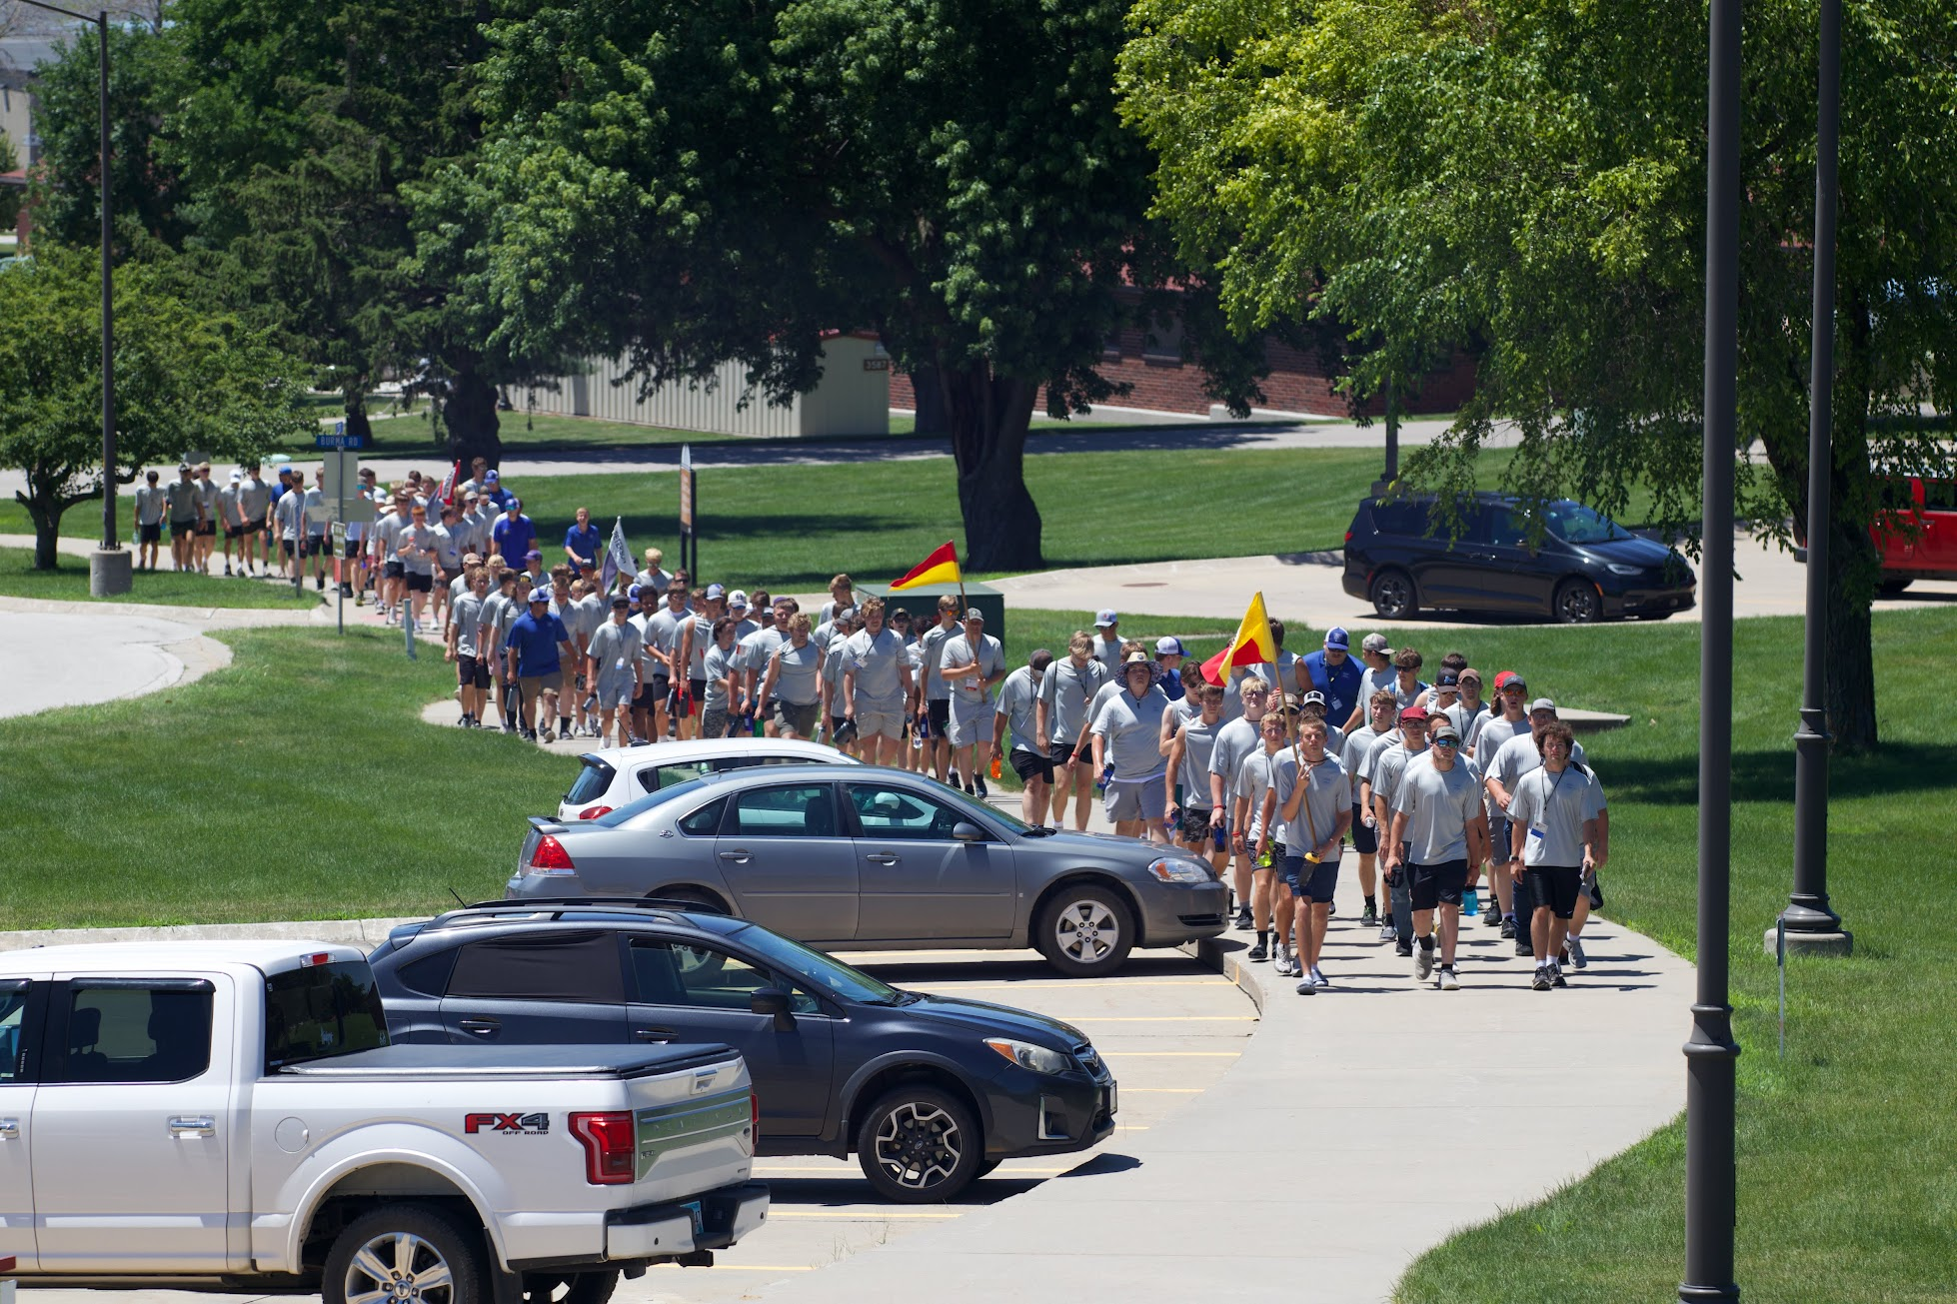
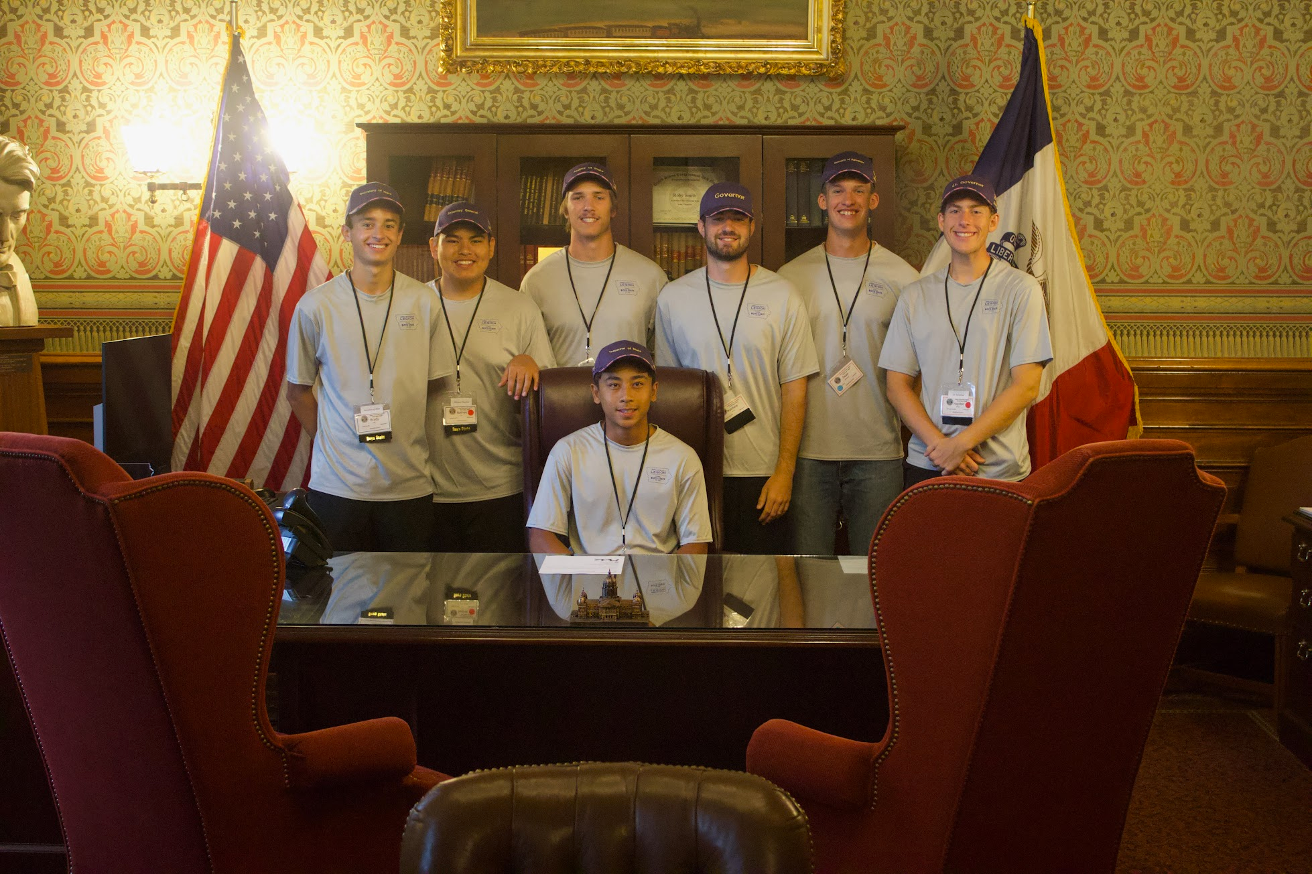
THE EXPERIENCE: WHAT IS BOYS STATE?
Leadership. Service. Legacy.
You're not just attending — you're building a government.
Established in 1938 by the American Legion of Iowa
You'll leave with confidence, connections, and pride.

Slide 4
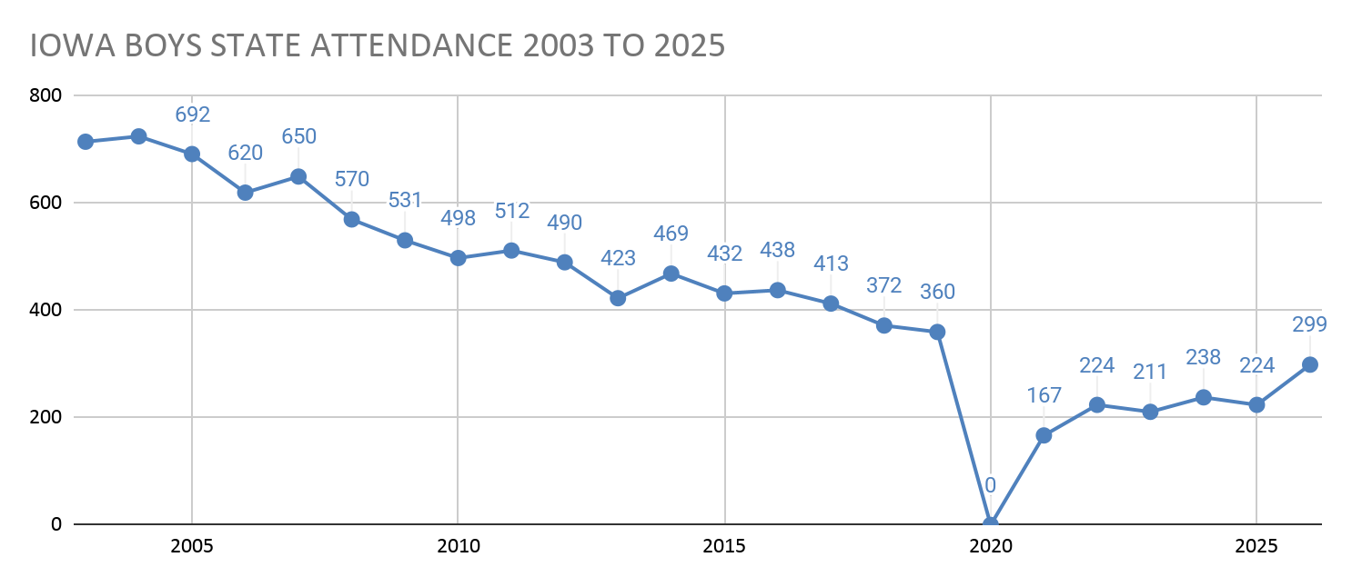

Slide 5
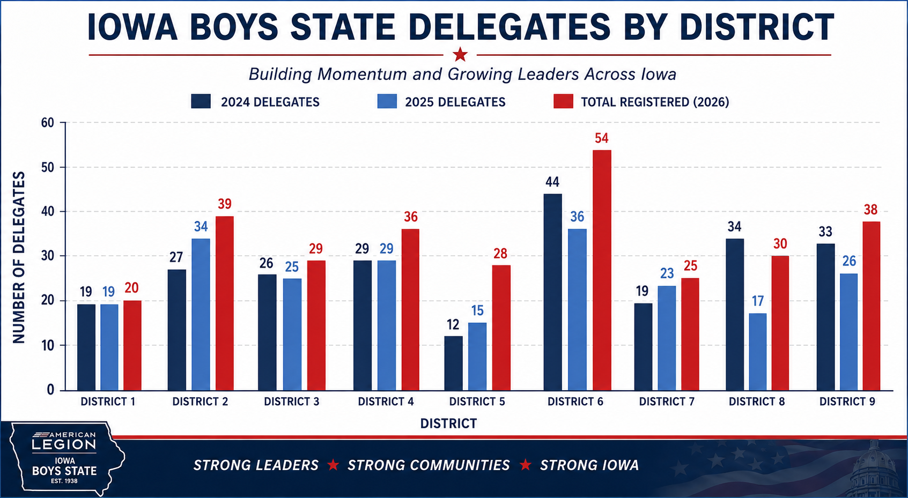

Slide 6
Where We Are Today
299 Registered Delegates
296 Students Completed Interest Form
165 Posts Sponsoring a Delegate
DISTRICT | COUNT OF POSTS
1 | 16
2 | 20
3 | 14
4 | 23
5 | 11
6 | 25
7 | 12
8 | 20
9 | 24
TOTALS | 165

Slide 7
2026 Recruitment Methods
Mailed packets direct to all Iowa High Schools (December 2025)
  Letter to Administrator
  Letter to Gov / Civics Teacher
  3 Flyers with QR Code to Interest Form
Encoura Data Purchase
  2000 Direct Mails “to the parents of:”
87 Interest Forms
Lesson Learned: At 2025 Boys State we got approx. 200 names for 2026, difficult to use due to no contact information provided by delegates.

Slide 8
New to 2026: Encoura Data
For the first time we purchased contact information
Iowa HS Juniors (class of 2027) that took the ACT test and has 3.0 or above GPA
Approx 2,000 contacts
Method used by other Boys State programs with successful outcomes
As of May 3rd:
Total matches (ACT list ↔ Interested list): 161 campers
Registration Breakdown (within those 161)
Registered: 98
Declined: 17
Undecided / Other: 46

Slide 9
New to 2026: Interest Form
For the first time we used an online interest form
Scan QR code - provide contact information
  Warm lead to push to District & Posts
296 Students / Parents filled out form
174 Registered (60% conversion)
125 Delegate Registrations that came from Post driven leads

Slide 10
Path to a Delegate
Delegate received information: packet, referral, letter, flyer
Delegate completed online interest form
Director emails contact information to District Task Force (District Commander, Vice-Commanders, Board Member)
Task Force contacts delegate / connects with local post
Post should determine eligibility / availability
Post secures sponsorship / registers delegate

Slide 11
Post Potential
We got 165 posts to sponsor a delegate.
We know there’s more out there, how do we stimulate engagement with posts not sending delegates?

Slide 12
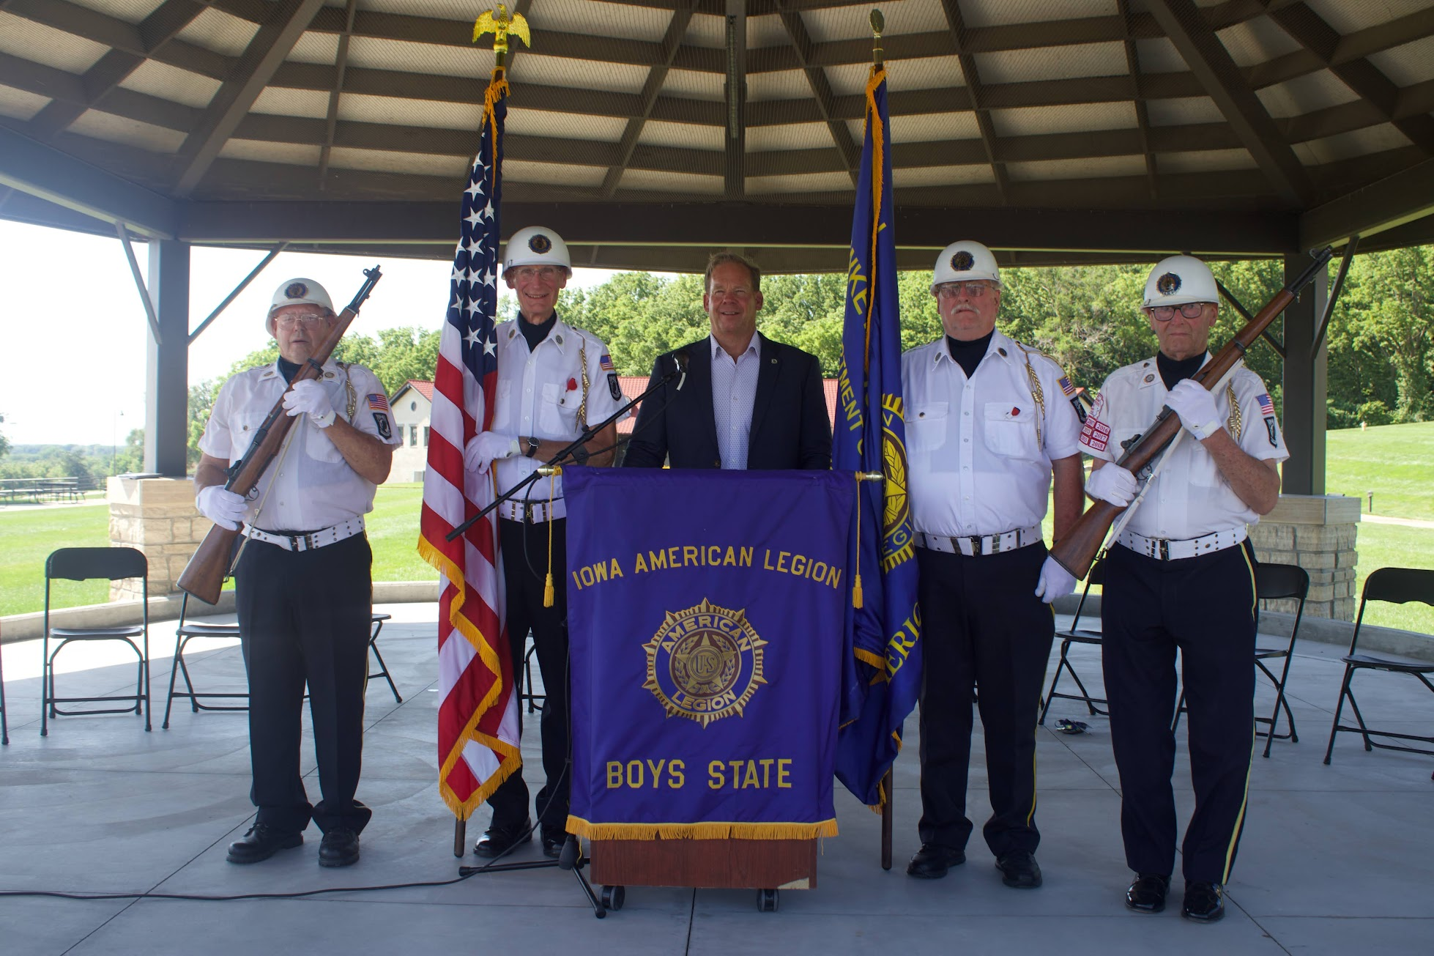
Recruitment Talking Points
Boys State offers significant value, and these points tend to resonate with parents and spark their interest.
Free to Attend
Parents don’t have to consider the financial burden - covered by our posts.
Stands Outs
Boys State is a unique opportunity that looks great on College Applications, Scholarship Applications, and interviews.
Scholarships
Access to over $25,000 in post-high school scholarship opportunities.

Slide 13
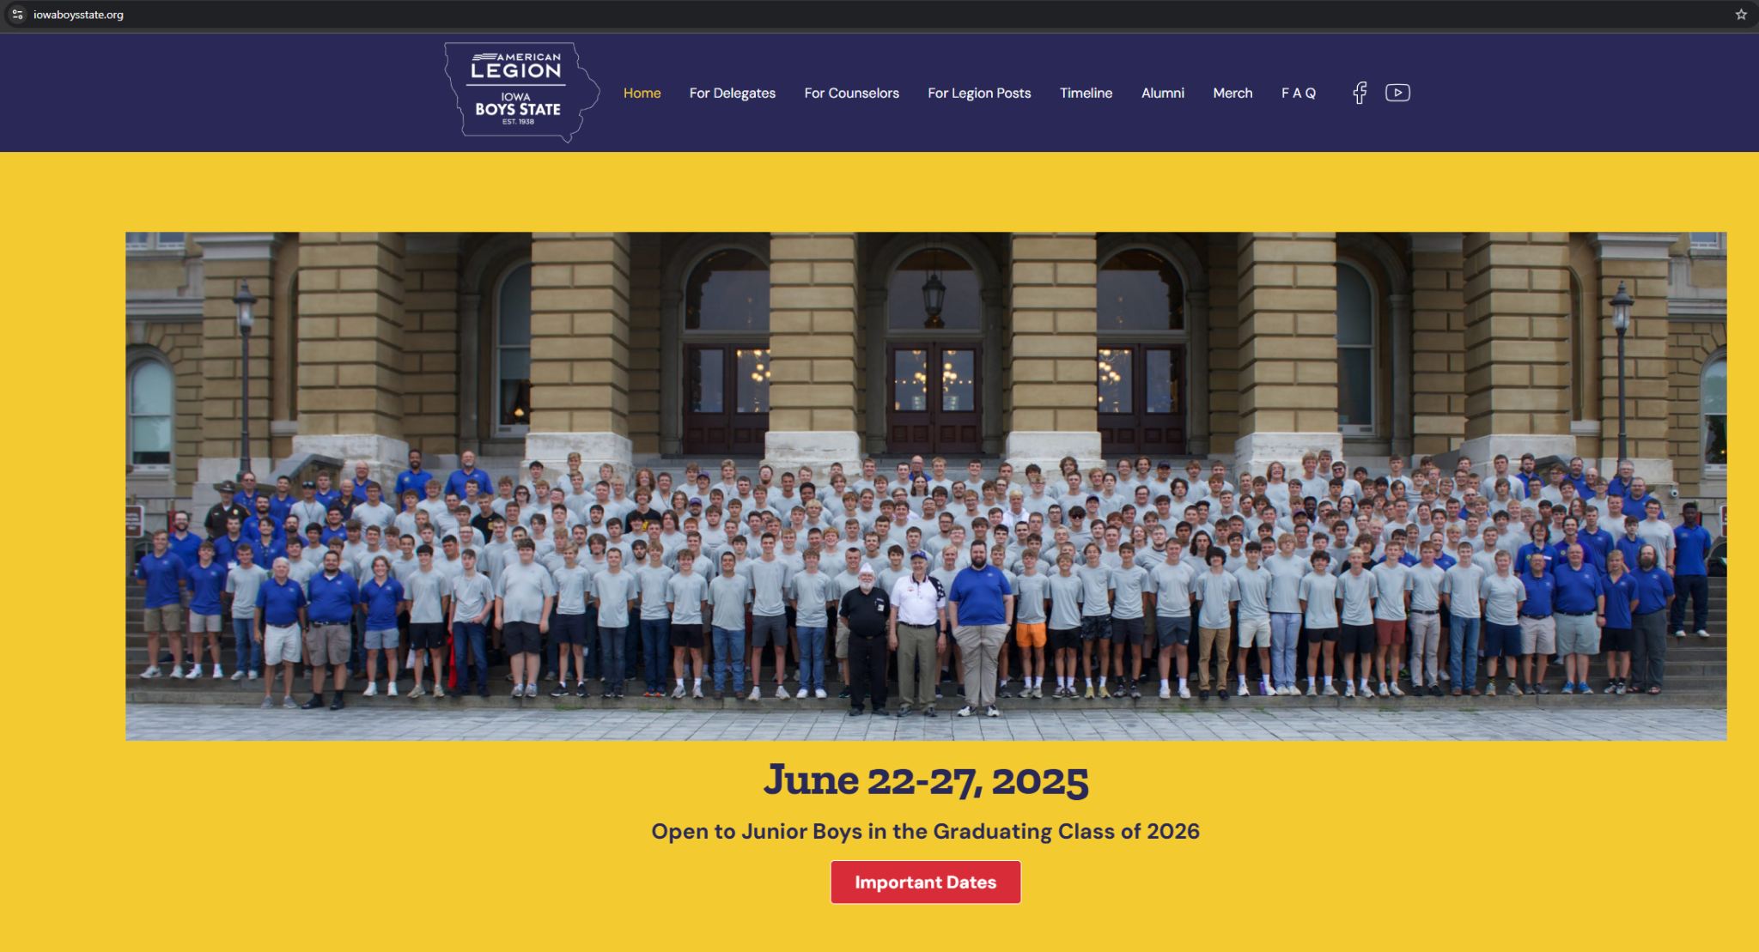
Recruitment Toolkit
We have a website!
www.iowaboysstate.org
We have a Marketing Toolkit Built Just for You!
  Special Note: Post Checklist

Slide 14




Finding Candidates
Historically Schools have provided the most success - not all schools support or are aware of Boys State now.
Other community groups to talk to:
Let’s talk about ideas! What works in your community?

Slide 15
Boys State 2026
June 21-26, 2026
Countdown to 2026 Boys State:
21 Days

Slide 16
Q&A
QUESTIONS?

