Slide 1

Be The One
Building and Creating your plan
Whitney Smith
Department of Iowa "Be The One" Chairman
Notes:
Thank you ahead of time for paying attention and keeping an open mind.
We are going to have an interactive session.
Before we go too far into things, be the one is an important topic but what is BTO?
2 minutes to write your answer.
In the department of Iowa BTO is putting suicide prevention into action.

Slide 2

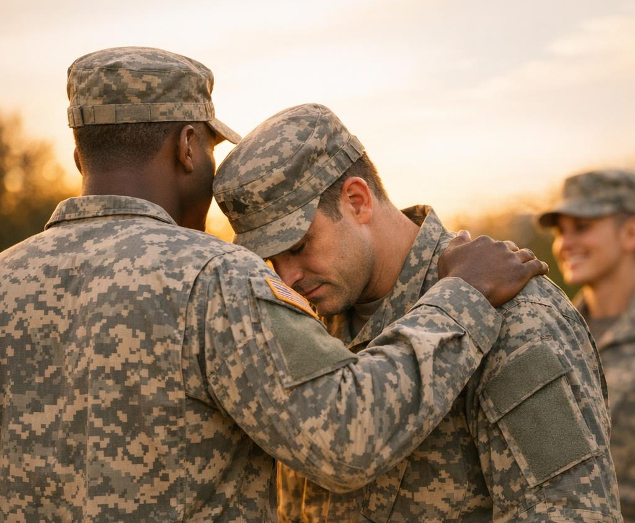
A Sensitive Conversation
Monitor Your Well-being
Talking about suicide is not easy. Some of us may be trauma or attempt survivors. It is alright to feel the personal impact.
Experience compassion fatigue? That's normal.
Feel free to take a break if needed.
Seek help if the weight becomes too much.
Notes:
At the end of this I am going to ask you what your post is going to do to address
Veteran Mental Wellness and suicide.
While going through the next slides please monitor yourself.

Slide 3


Myths vs. Facts
Myth
Myth
"Only experts can prevent suicide."
"Asking about suicide will make them angry."
Fact
Fact
Suicide is everyone's business. Almost any positive action may save a life.
Asking directly lowers anxiety and opens vital communication channels.
Notes:
Anyone can intervene.
No one has to intervene.
What does intervention look like?
Trust your intuition.
The next slides will show training opportunities that will teach intervention techniques.
Myth 2…anger

Slide 4
Words Matter: Proper Language
STANDARD VERBAGE | PERSON CENTERED VERBAGE | Why?
"Commit" suicide | Died by suicide / Lost their life | "Commit" implies a CHOICE.
"Successful" suicide | Fatal attempt / Died by suicide | Frames tragedy as an achievement.
"Suicidal" person | Experiencing suicidal thoughts | Thoughts do not define the individual.
"Mentally ill" / "Addicts" | People with mental illness / substance use | Person-first language shows respect.
Notes:
"Commit" suicide
Died by suicide / Lost their life
"Commit" implies a CHOICE.
"Successful" suicide
Fatal attempt / Died by suicide
Frames tragedy as an achievement.
"Suicidal" person
Experiencing suicidal thoughts
Thoughts do not define the individual.
"Mentally ill" / "Addicts"
People with mental illness / substance use
Person-first language shows respect.

Slide 5
Barriers to Suicide Intervention
In the Veteran Community
Generational issues
Fear of making things worse
The elephant in the room
Mis-information
Notes:
What are some issues to embracing…getting comfortable with…. Veteran Mental Wellness?
Generational…
What generation are you
Biases
lets visit the history inside of the legion.

Slide 6
History of Prevention (1921-2019)
1921
2009
2019
Neuropsychiatric Awareness: First recognition that "shell shock" required specialized care.
Resolution 51: Formally established the first Legion-wide suicide referral program.
Resolution 18: Launched "Buddy Checks" as an official national program.

Slide 7
The Current Mission (2022-2026)
2022
2023
2024-2026
"Be The One": Redefined prevention as a peer-to-peer mission for every member.
VA Buddy Check: The U.S. Govt adopted the Legion's model via the STRONG Veterans Act.
The Current Watch: Integrating TRAINING, MENTORSHIP & ADVOACY into one toolkit.

Slide 8





The Prevention Toolkit
VA S.A.V.E.
Columbia Protocol
QPR
ASIST
Veteran-specific, quick prevention training. Free and online.
Question, Persuade, Refer. Teaches life-saving conversations.
In-depth for front-line responders and crisis intervention.
Evidence-based assessment for everyday use by everyone.
30-60 Minutes
90m - 2 Hours
2 Days
90 Minutes
Notes:
Fear of making things worse…
Best way to get past fear…face it learn something

Slide 9


Columbia Protocol: Risk ID
Identifying Severity
Triage works by scoring risk based on specific questions about ideation and behavior.
Low: Wish to be dead / Thoughts of suicide.
Moderate: Suicidal thoughts with some intent.
High: Specific plans, intent, or recent behavior.
If Question 4 or 5 is YES: Seek immediate help.

Slide 10

QPR: Question, Persuade, Refer
A Beacon of Hope
QPR is not intended to be a form of counseling or clinical treatment. Instead, it is a tool to offer hope through positive action.
It empowers every member to be a "Gatekeeper" who can identify a crisis and navigate a fellow veteran toward the help they deserve.

Slide 11




Nationwide Support Network
988 Lifeline
Vets Center
VA Mental Health
Call or Text 988. Press 1 for Veterans. Immediate 24/7 crisis support.
Community-based counseling and social services for veterans.
Comprehensive clinical treatment and resource information.
American Legion
Tools, ideas, and training materials for your post.
https://www.legion.org/advocacy/be-the-one
Stop Soldier Suicide
Wounded Warrior
Focused solely on preventing suicide among US veterans.
Mental health programs for veterans and their families.
Notes:
How do you eat an elephant?
One bite at a time?
What happens when the elephant is on fire and charging you?
Reach out to respources.

Slide 12
Iowa Spotlight: Service in Action
SALUTE TO THE FALLEN:
John Thomson: After his service, John started a mission to ensure no veteran feels forgotten. The Guardian Response Unit repurposed an ambulance for mental health crisis response.
Iowa American Legion QPR Team: 7 certified gatekeepers across Iowa districts now serve as beacons for veterans in need.
Real impact happens when we transition from awareness to action
Notes:
Misinformation…
Each department and District and post approaches BTO differently.
Let me tell you what Iowa as a department and as a group of organizations has done.
YSS
Salute to the fallen
American Legion
The ones I have mentioned are taking action

Slide 13

What are your plans?
The Department of Iowa is committed to saving lives. How will your District or Post implement "Be The One" this year?
Whitney Smith
Smithmcintosh.alia@gmail.com

Slide 14




Image Sources
https://dehayf5mhw1h7.cloudfront.net/wp-content/uploads/sites/2030/2024/11/20120450/american-legion-be-the-one-1024x576.webp
Source: www.1380kcim.com
https://news.va.gov/wp-content/uploads/sites/3/2025/07/BSF.jpg
Source: news.va.gov
https://cssrs.columbia.edu/wp-content/themes/sage-8/dist/images/logo.png
Source: cssrs.columbia.edu
http://static1.squarespace.com/static/5be1c3c5c3c16a5e97de388d/6659ee657c6bb222d6ede5fb/6669e49d225efe507d31743a/1735493731950/QPR+Logo.png?format=1500w
Source: www.indianaprevention.org
https://upload.wikimedia.org/wikipedia/commons/thumb/c/cf/American_Legion_Seal_SVG.svg/330px-American_Legion_Seal_SVG.svg.png?_=20220801165521
Source: commons.wikimedia.org

